Slide 1

October 2025
EMPOWERING YOUR FUTURE AS AN EACA MEMBER

Slide 2


ABOUT US
>3,000
member agencies
>120,000 employees
represented
>30
countries
29 yrs
running
Effie Awards Europe
Founding member of VoxComm
the global voice
for agencies
Notes:
2

Slide 3

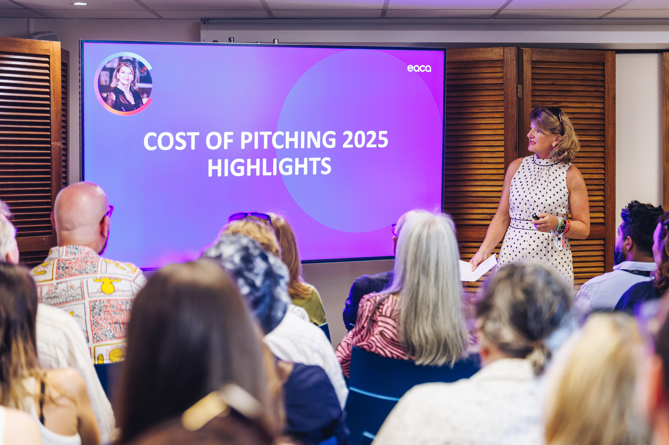
MISSION

Slide 4
COMMUNICATIONS
REPUTATION
MEMBERSHIP
Mission
We exist to serve our members, both agencies and national associations, to help them grow and sustain their business.
We set the standards, creating relevancy and visibility for the industry.
And in doing so, we enhance its value and reputation across Europe.
Notes:
4

Slide 5
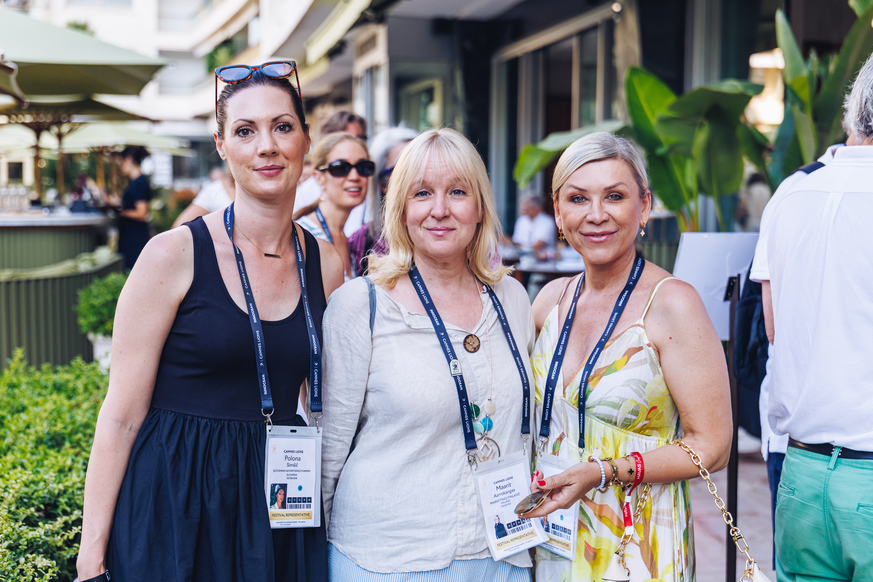
OUR
PILLARS

Slide 6


Slide 7

We tackle common industry challenges by reinforcing co-creation and collaboration across EACA members.
co-creating

Slide 8

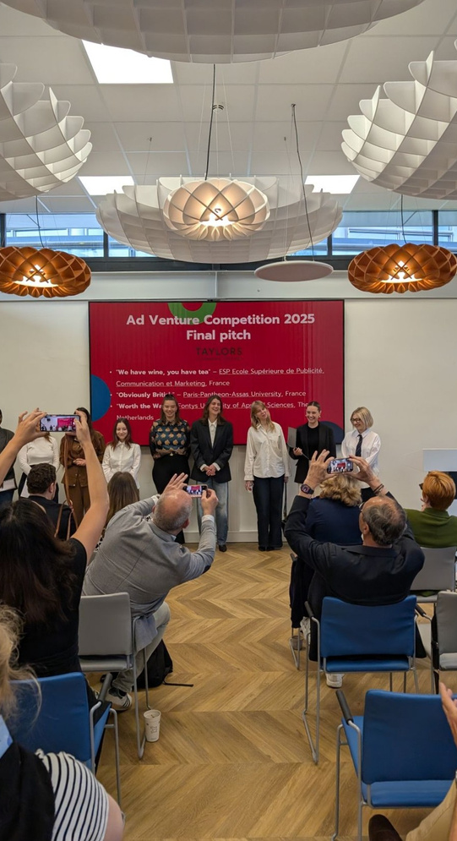
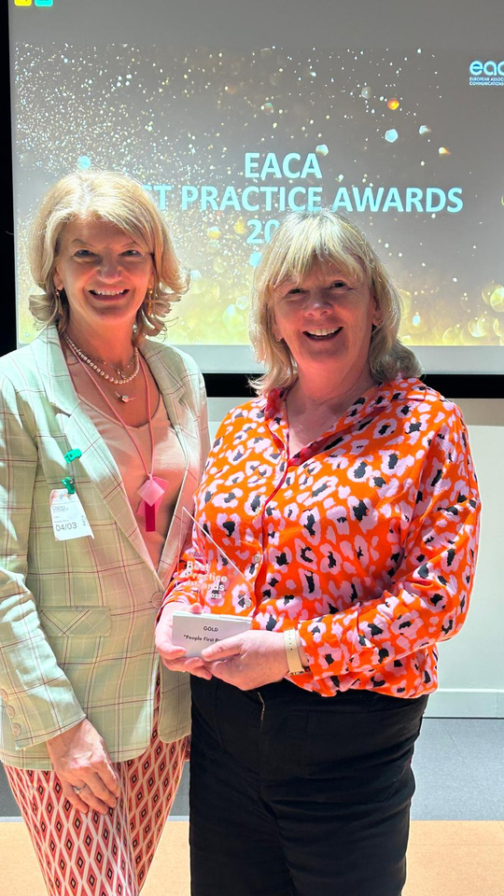

co-creating
  Facilitating knowledge exchange through our Councils, Steering Groups, and Task Forces.
  Sparking inspiration through awards and events.
  Educating talent through academic partnerships and European student competitions.
  Strengthening the industry and community building.
  Establishing best practice through the EACA Best Practice Awards.
Notes:
8

Slide 9
We position EACA as
the authoritative agency voice
with EU-policymakers and the industry.
advocating

Slide 10
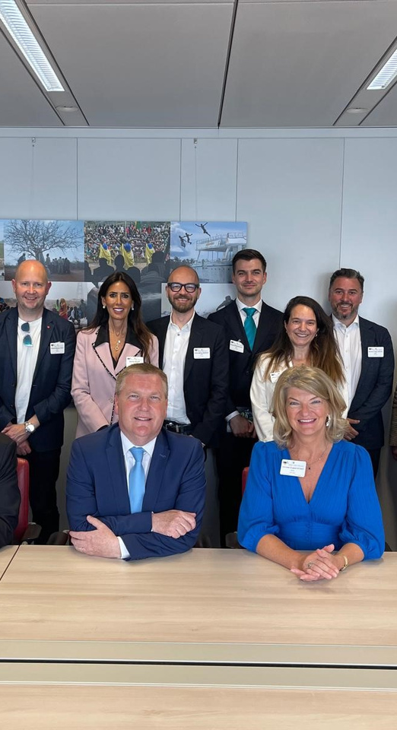

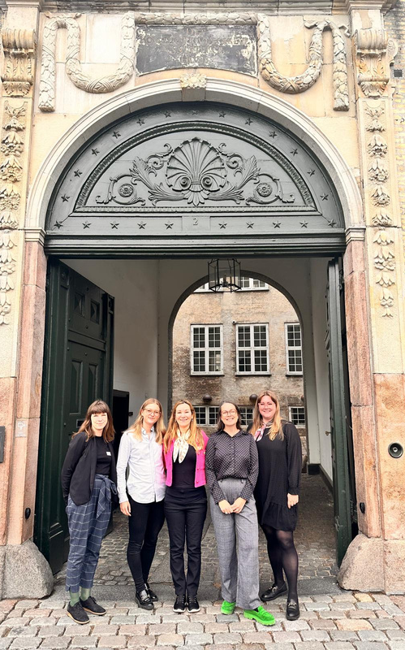

advocating
  Establishing a reputation within the EU Commission and MEPs through our PA strategy.
  Supporting members through regular PA updates, practitioner’s guides, and ad-hoc reports.
  Participating in public consultations on relevant industry matters and drafting joint opinions.
  EU Presidency snapshots
  Enhancing the reputation of the advertising industry as facilitators of positive societal change.

Slide 11
communicating
To increase EACA’s visibility within all key stakeholder groups.

Slide 12
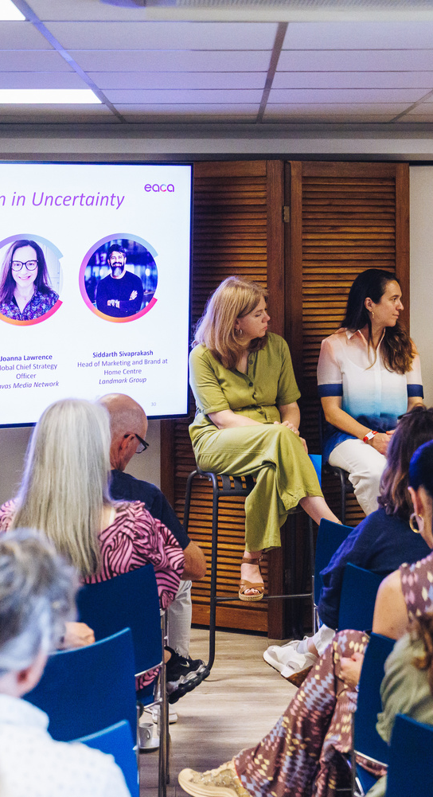
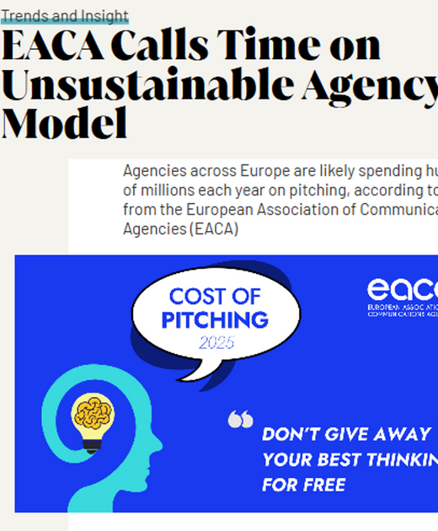
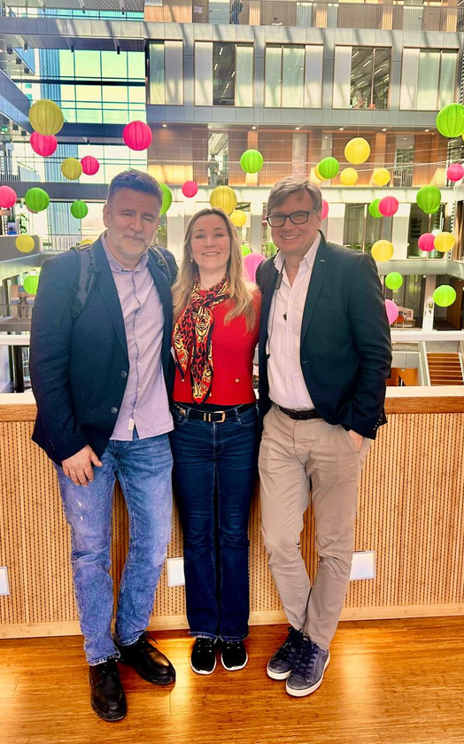

communicating
  Commissioning & providing tailored Europe-wide research to inform our members.
  Establishing a strategic POV for the industry across common industry challenges.
  Setting standards for fairer pitching and business practices.
  Establishing a single-minded AI Think Tank specifically to help design the agency of the future.

Slide 13
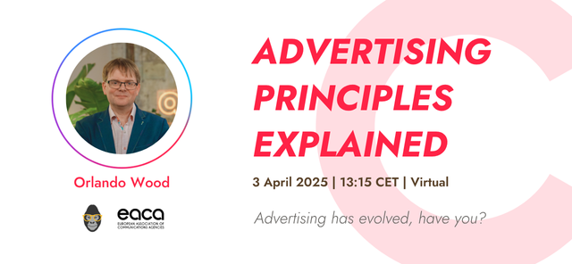


Offering
member-exclusive programmes
  Expert webinars and C-level workshops.
  Meetings with leading policymakers and regulatory bodies.
  Behind-the-scenes access to tailored industry-wide research.
  Access to industry training and education opportunities.

Slide 14
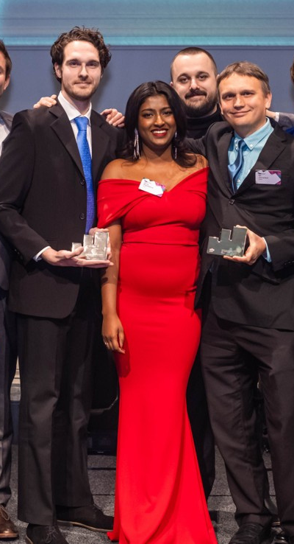
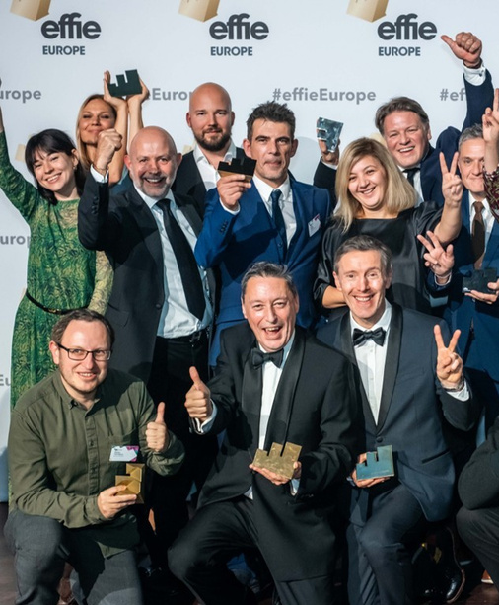


Celebrating your success
across Europe:
Effie Awards Europe
As an EACA member, you have access to:
  Exclusive entry discounts to Europe’s leading awards for creativity and effectiveness, the Effie Awards Europe that EACA runs & leads.
  Inspiration from top-performing, award-winning campaigns.
  High-level networking with creative and strategic industry leaders.
  The Effectiveness Conference with cutting-edge and influential high-level speakers.

Slide 15
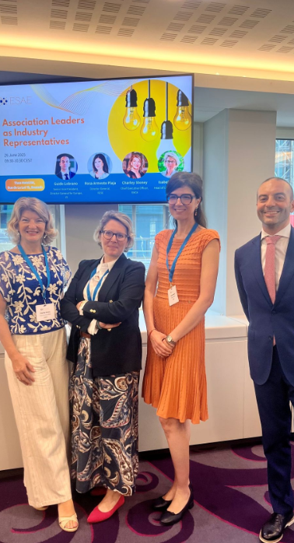
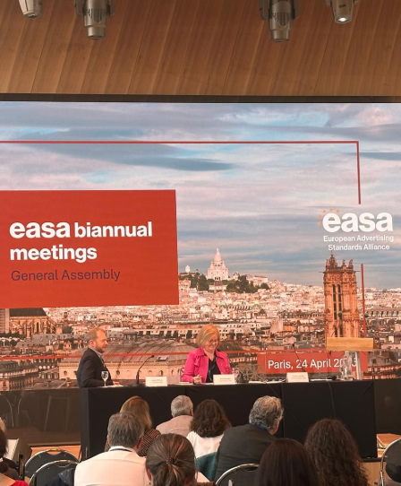
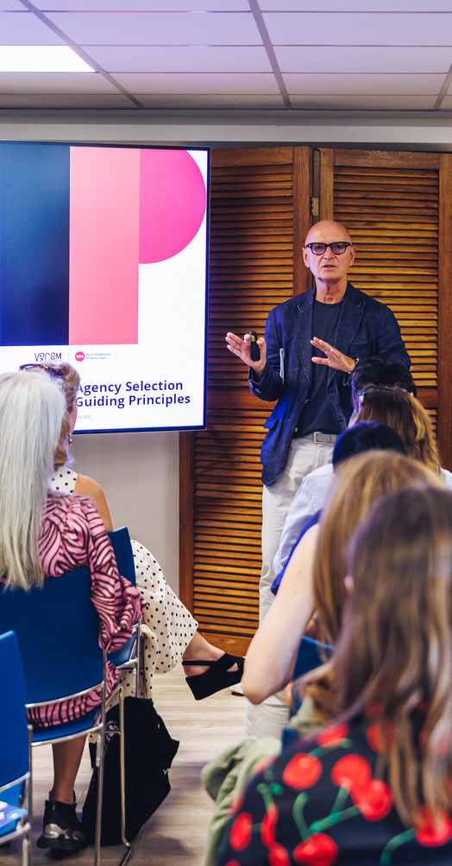
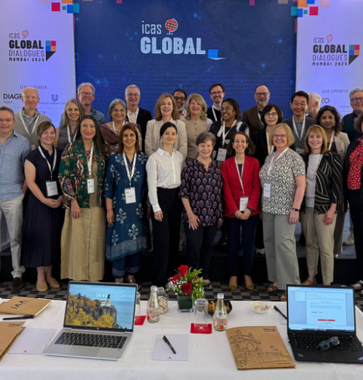
Partnering with key industry stakeholders
  Enhancing value through continuous engagement with strategic and global industry partners – WFA, EASA, IAB, Egta, VoxComm Alliance, ICAS, etc.
  Forging strong partnerships with industry leaders to amplify our influence & agency voice on both European and international stages.

Slide 16
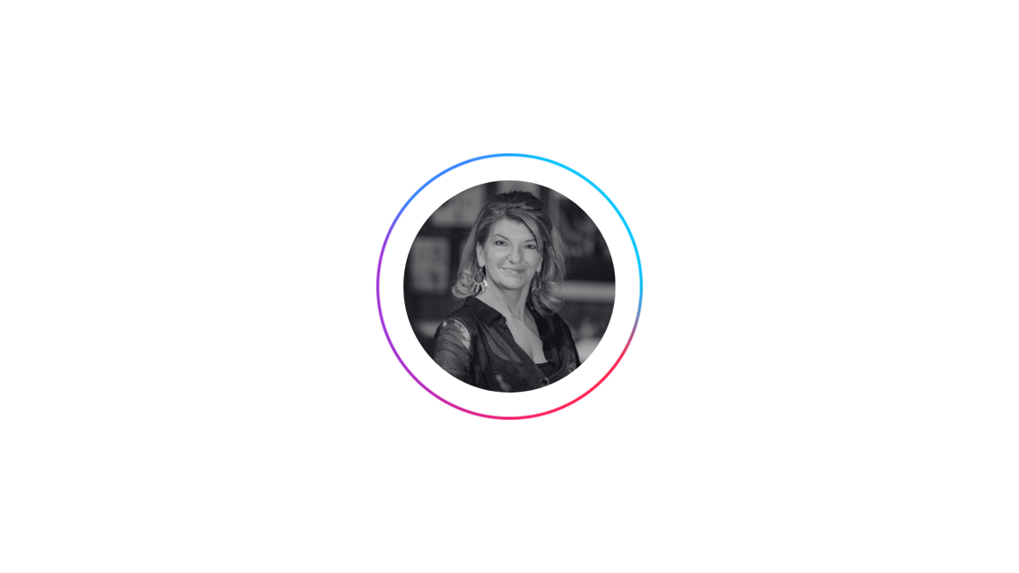
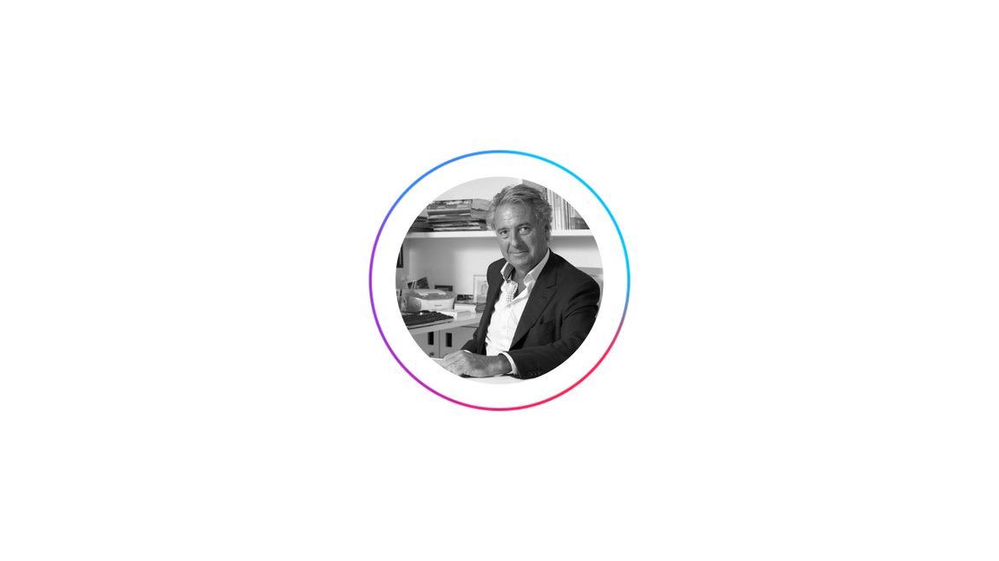

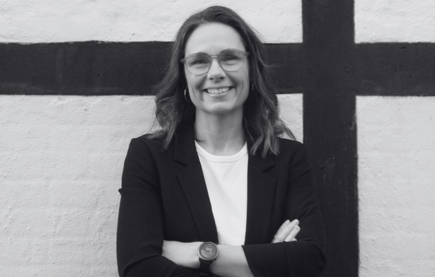
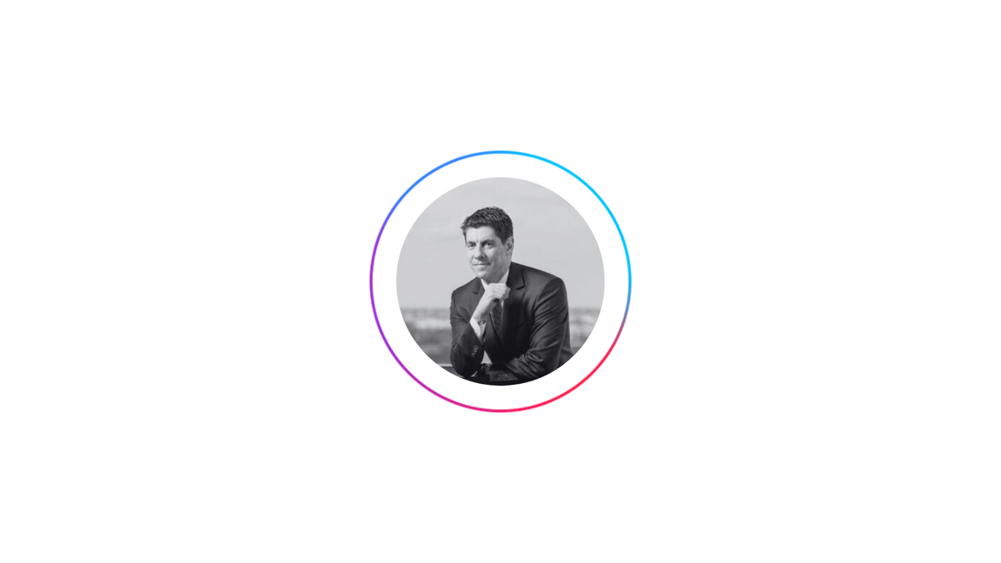

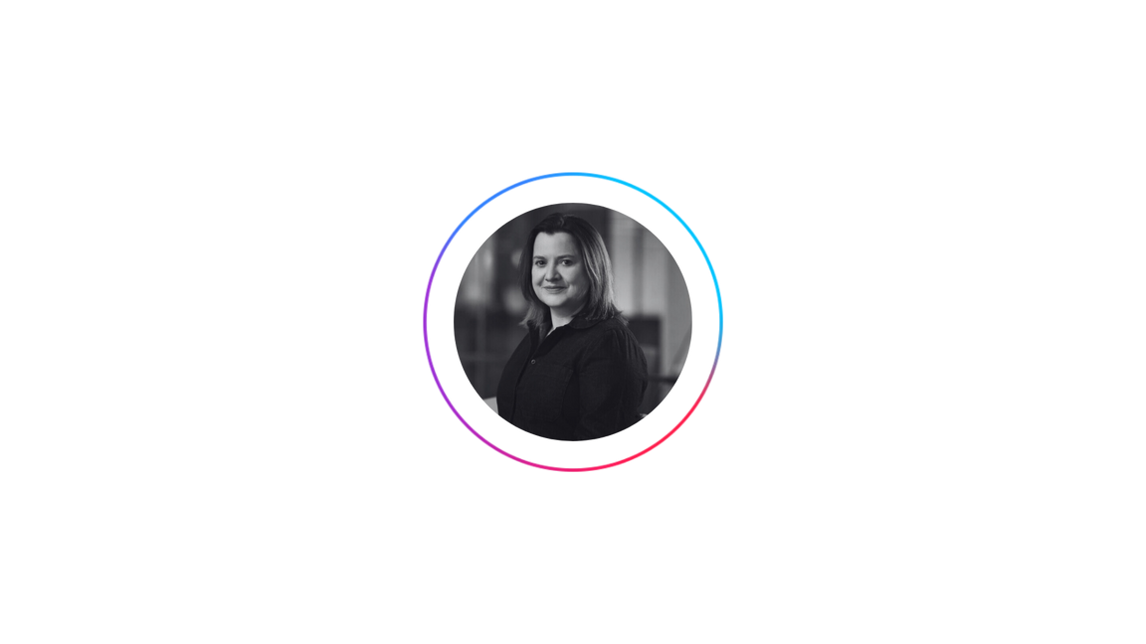
EACA BOARD
Charley Stoney
CEO, EACA
Christian de La Villehuchet
Global Chief Integration Officer, Havas
Malene Birkebæk
CEO, Kreativitet & Kommunikation
Radu Florescu
Vice President, UAPR Romania
Johan Boserup
Global CEO Investment, Omnicom Media Group
Caroline Howe
CEO EMEA & UK, Ogilvy Health

Slide 17

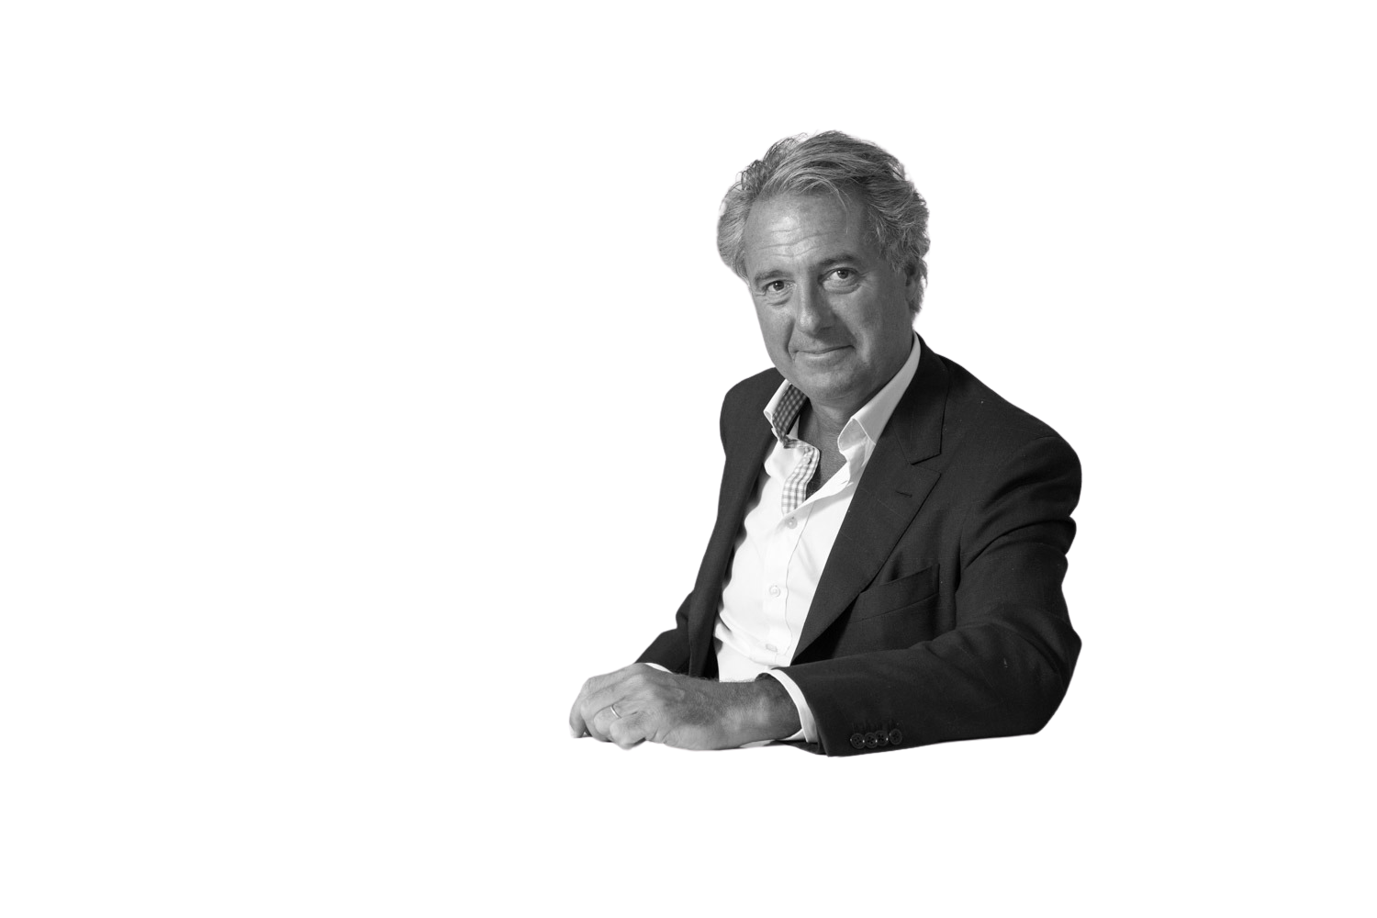

This is a pivotal time for advertising across Europe. Our business faces significant challenges as well as tremendous opportunities.
At the EACA, we are doing everything we can to promote, protect and propel our industry forward.
Our unique alliance of the leading media and creative agencies in Europe along with national associations from right across the region, places us at the heart of the continent's business agenda.
Come join us!
Christian de la Villehuchet
EACA President
Global Chief Integration Officer, Havas Group

Slide 18

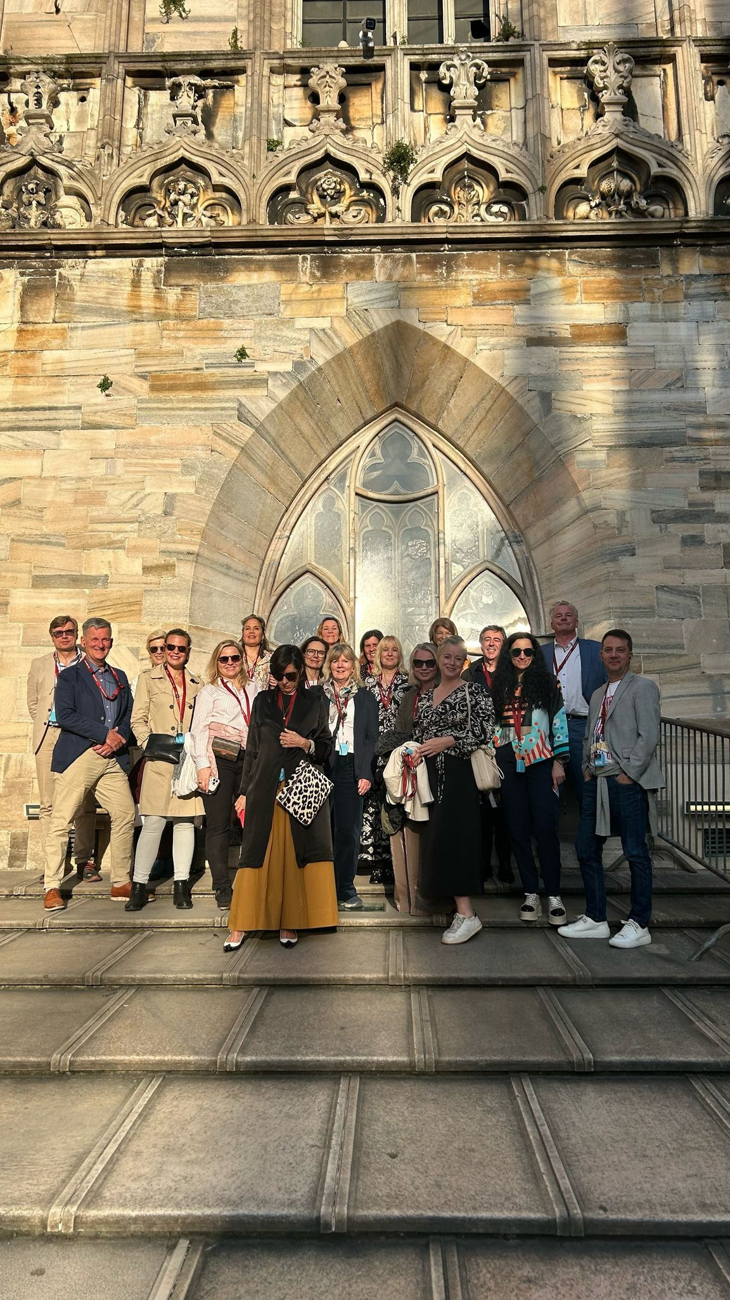
BRING YOUR VALUE
& JOIN THE NAC
Steal with pride across Europe
  Protect your interests by setting up industry standards across Europe.
  Lead & shape the industry by connecting with your European peers, industry key players and policymakers.
  Foster a broad and powerful community through collective events and high-level initiatives.
  Share and reward industry best practices through our Best Practice Awards programme.
  Empower your agencies and secure your future through training modules and certifications at discounted rates.

Slide 19

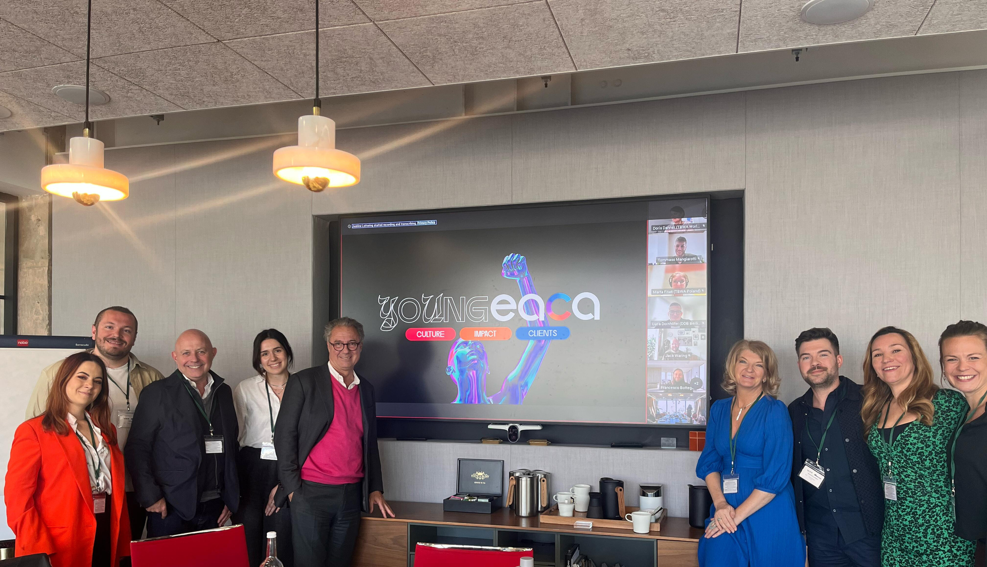
BRING YOUR VALUE
& JOIN THE IAC
We won’t give away our creativity and IP
  Protect your interests and shape industry standards across Europe.
  Connect with peers, industry leaders, and policymakers across Europe.
  Strengthen the industry’s voice and creativity value through unified advocacy and collective initiatives.
  Showcase creative leaders on the European stage, including notably Effie Awards Europe.
  Empower emerging talent through the impactful Young Board initiative.
  Promote inclusion and female leadership with strategic partnerships.

Slide 20


BRING YOUR VALUE
& JOIN THE MAC
Setting sustainable and high standards
for media agencies across Europe
  Shape industry standards to protect your interests across Europe.
  Connect with peers, key industry players, and policymakers to lead the sector.
  Influence decisions through joint position papers and strategic initiatives.
  Access and engage directly with policymakers on regulatory and market developments.
  Promote transparency and effective practices through shared governance guidelines.
  Align around a strong, unified voice on critical media agency issues.

Slide 21

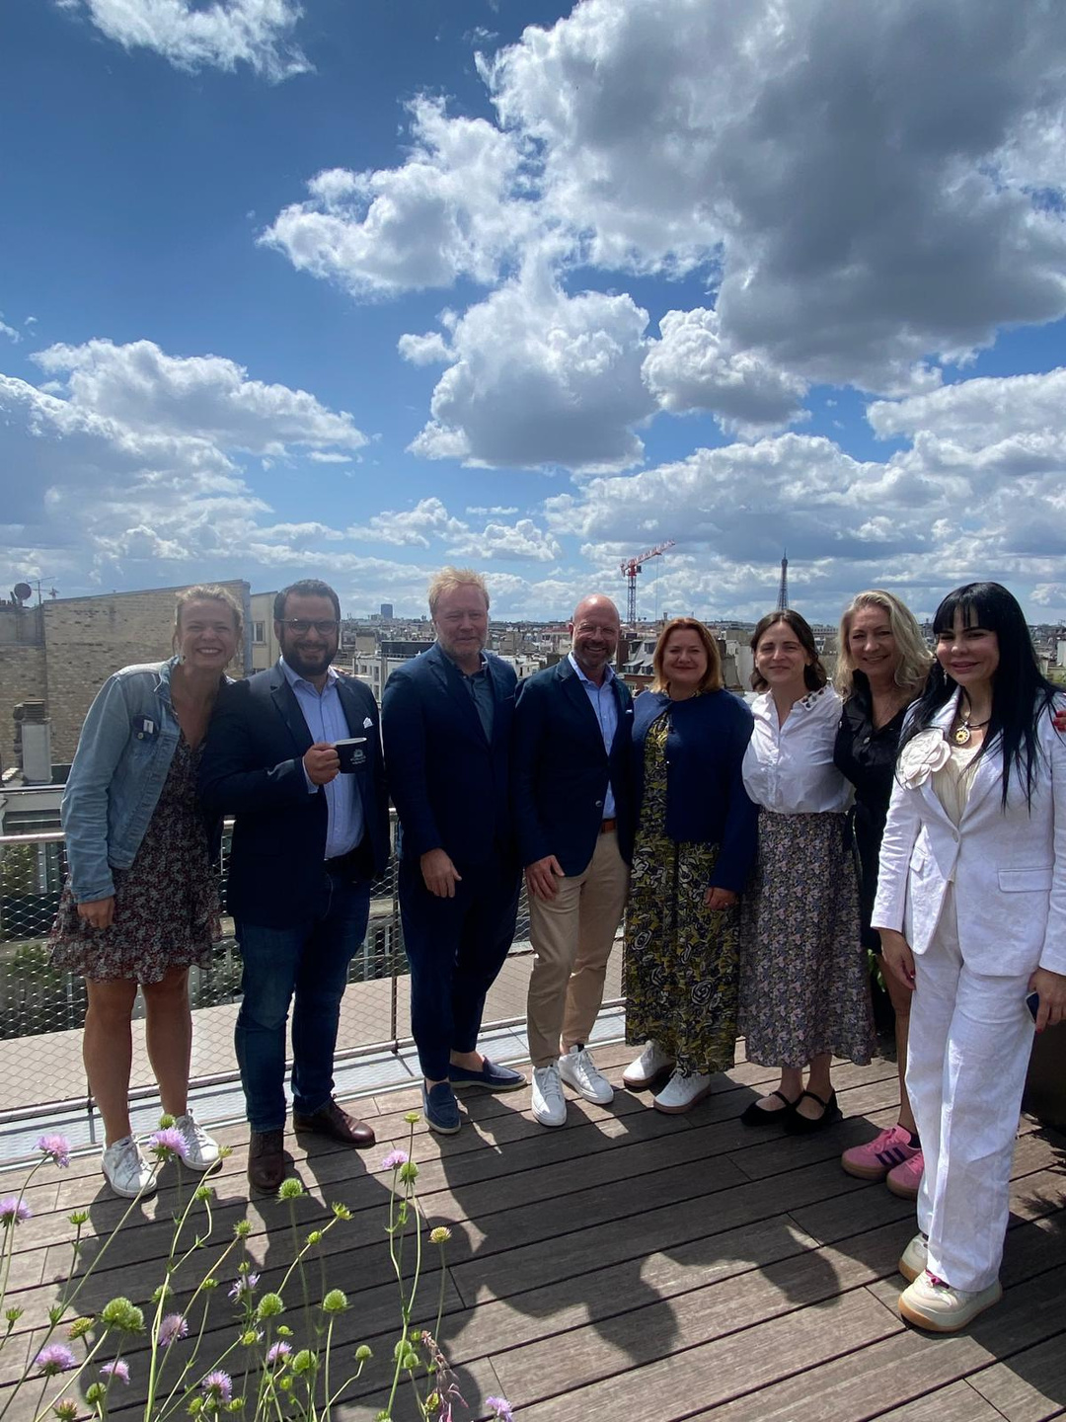
BRING YOUR VALUE
& JOIN THE HCC
To shape the healthcare comms landscape in Europe
  Protect your interests and shape industry standards across Europe.
  Connect with peers, industry leaders, and policymakers across Europe.
  Strengthen the industry’s voice through unified advocacy.
  Showcase the transformative value of Specialist Health Agencies.
  Celebrate quality, credibility, and innovation with the new Health Effectiveness Effie.

Slide 22

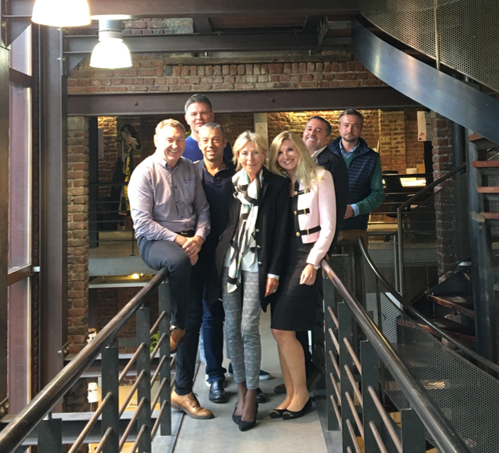
BRING YOUR VALUE
& JOIN THE IMPACT
Small campaigns for big impact
  Protect your interests by advocating for high industry standards and effective practices across Europe.
  Lead and shape the industry by connecting with your European peers, industry key players and policymakers.
  Foster a broad and powerful community through collective events and high-level initiatives.
  Share and reward the best IMPACT across Europe through the IMPACT Awards.
  Empower your agencies and secure your future through training modules and certifications at discounted rates.

Slide 23

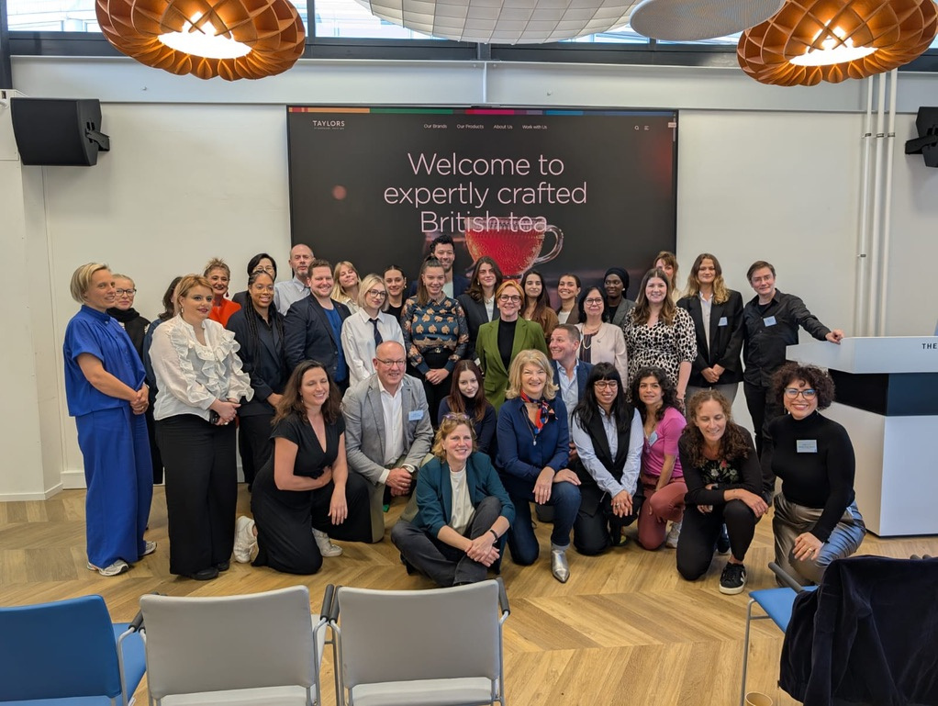
BRING YOUR VALUE
& JOIN EDCOM
Training tomorrow's talents
  Forge powerful connections between the commercial communications sector and academic partners
  Drive excellence in education and research
  Share updates from member universities and foster collaboration
  Take part and promote the Ad Venture Competition and Graduation Competition to your students
  Offer international mobility

Slide 24



